Slide 1
Camera Project Debugging
July 29

Slide 2
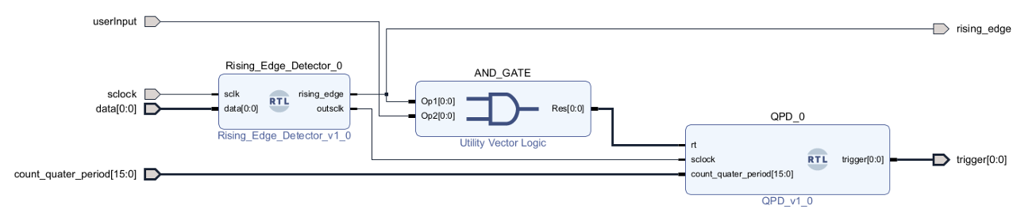
Verilog Code

Slide 3
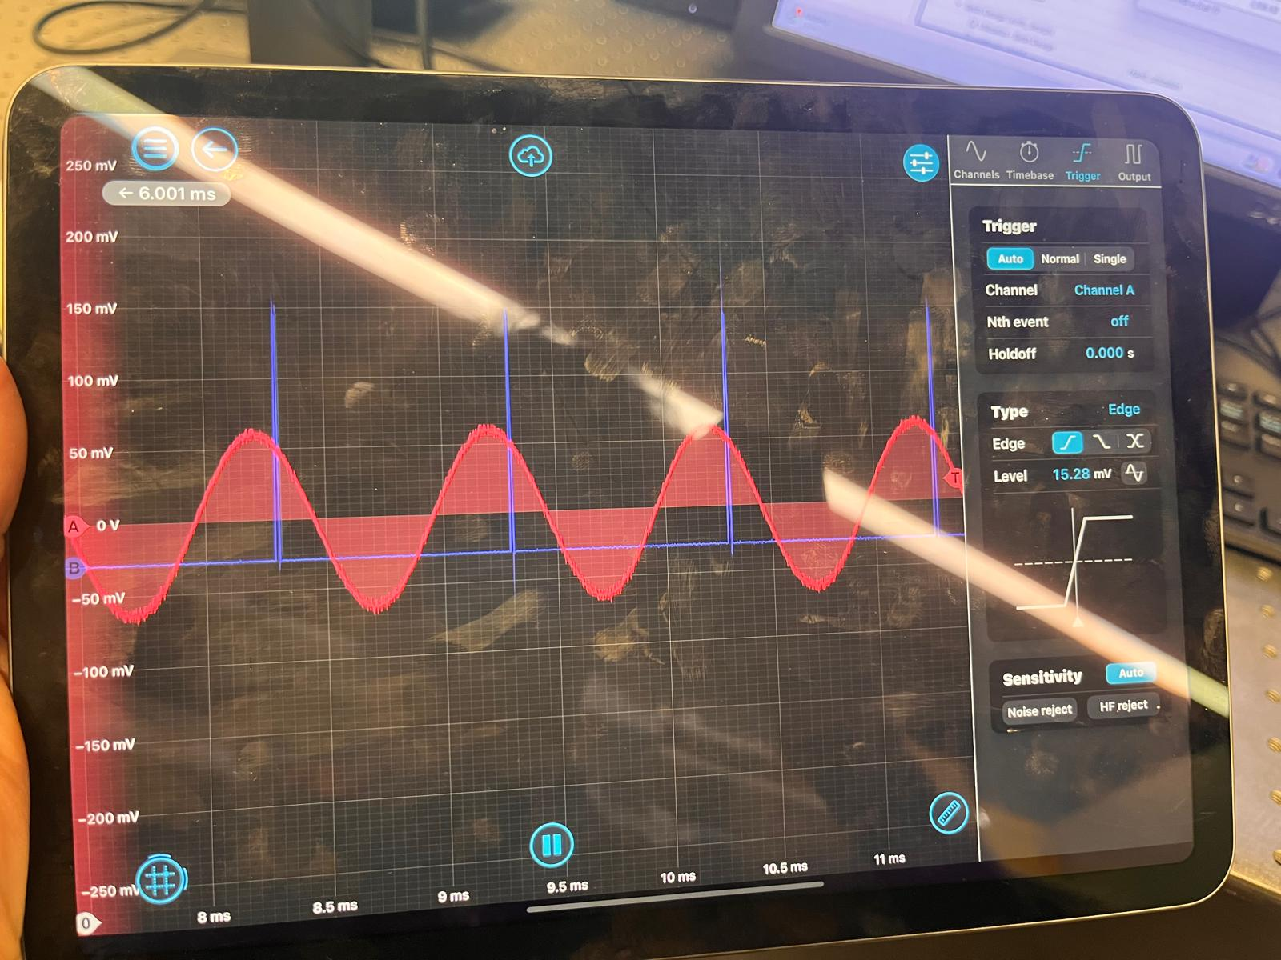
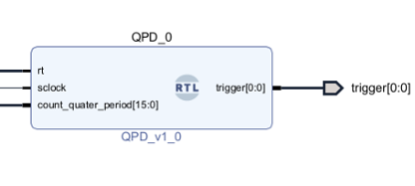
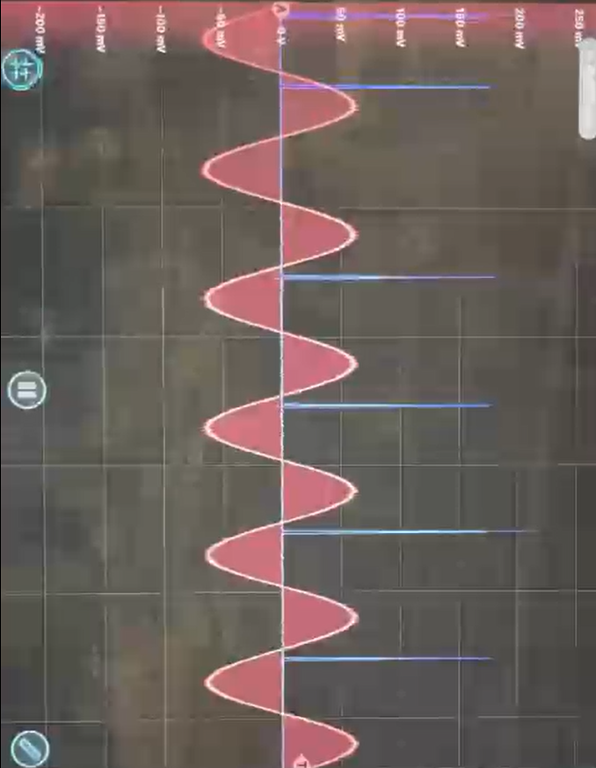
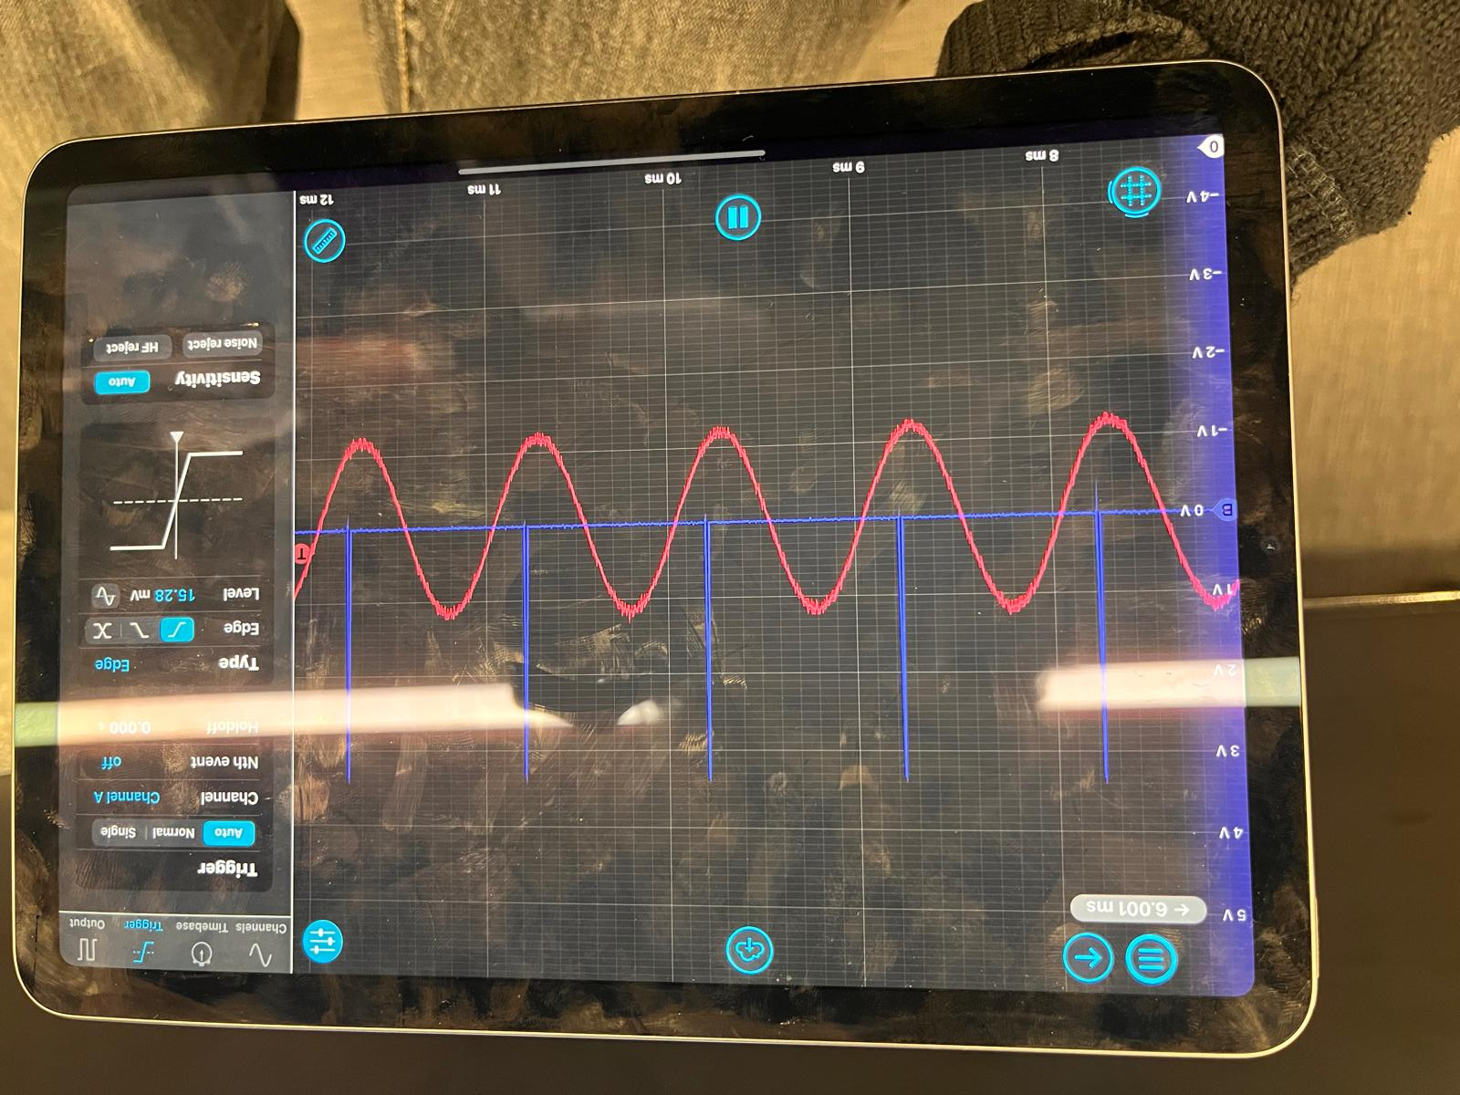
Is it the Delay logic?
Delay logic is fine! Each hard coded delay works

Slide 4
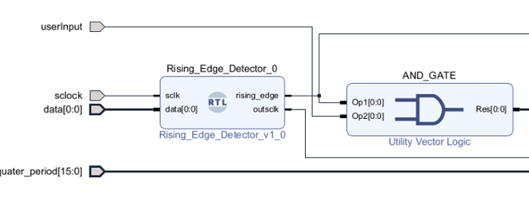
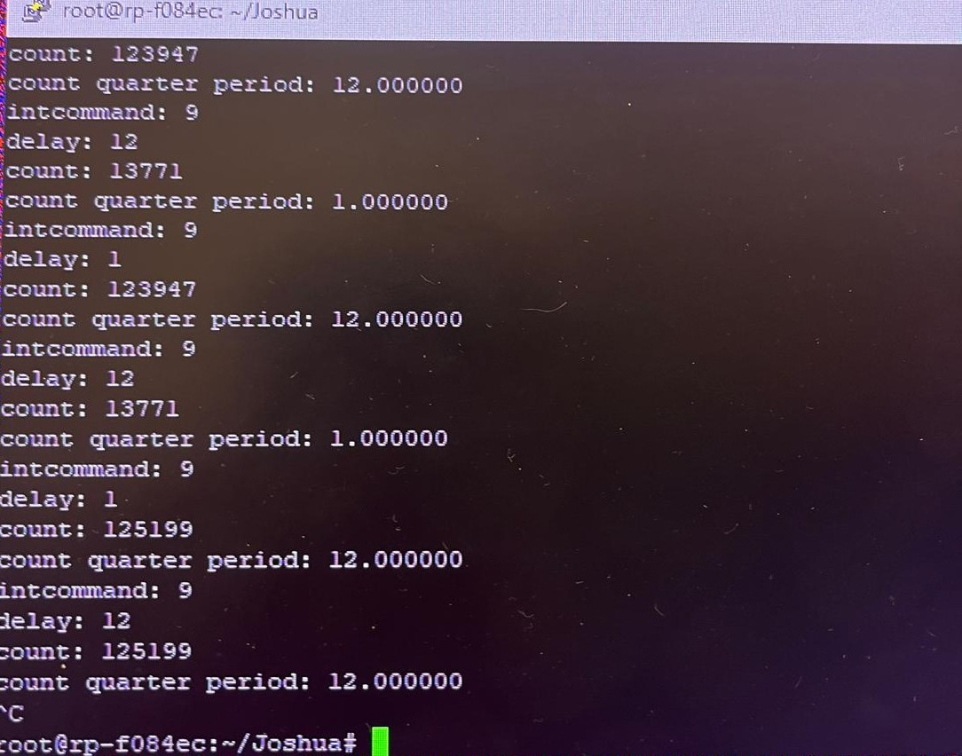
Is it before the Delay Logic?
This AND gate checks for
1. Rising edge in signal
2. User Requests trigger
Currently, this outputs nothing
Switching to an OR gate: Rising edge pulses
This means that the “camera is ready” communication is not being read from the FPGA
The server on the RP processor shows the delays being sent, but the FPGA doesn’t
This is a PC -> FPGA issue NOT PC -> Processor

Slide 5
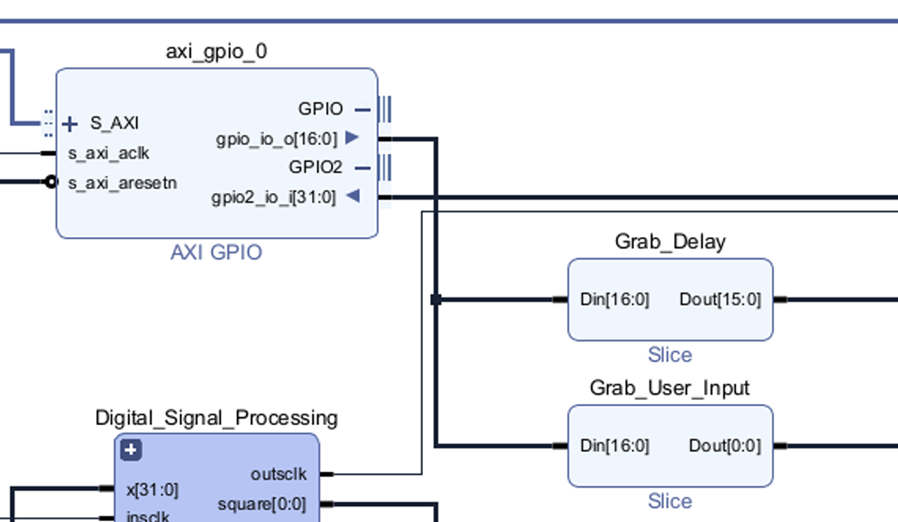
Communication Logic
The “Grab_Delay” and “Grab_User_Input” handle the communiciation from the PC to the FPGA
I wired this to an LED, and out put was nothing
If we can get the FPGA to read the info from the PC, then we can allow the delays to be controlled by the PC

Slide 6
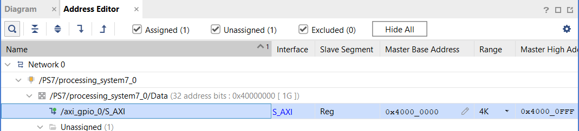
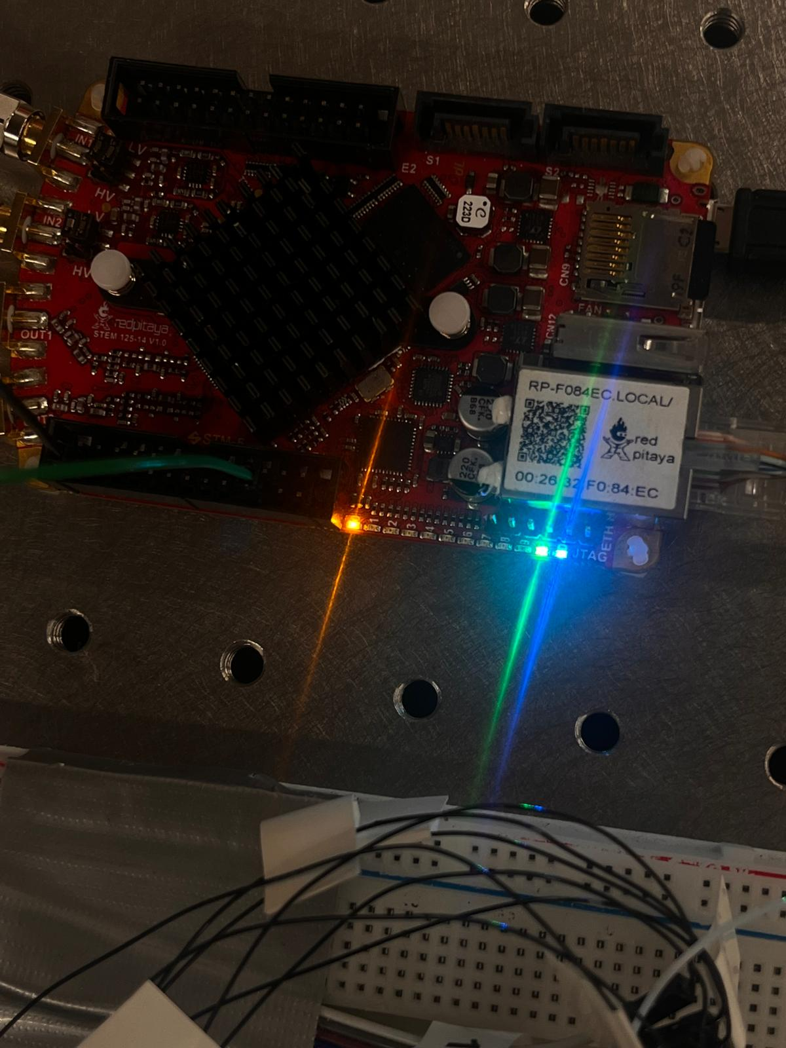
Fixing the communication issue
There was a mismatch between what address the server would write to the FPGA and which address the FPGA would read from…
Setting the FPGA to read from 0x41200000, then wire to LED made this connection work!

Slide 7
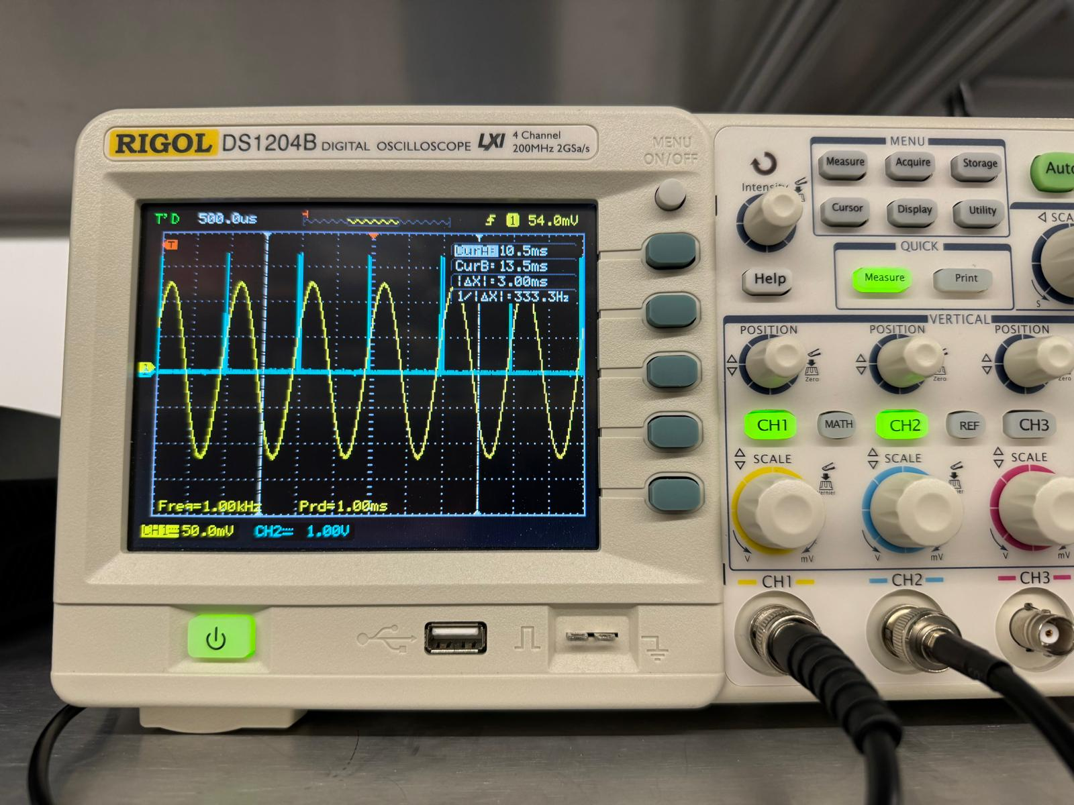
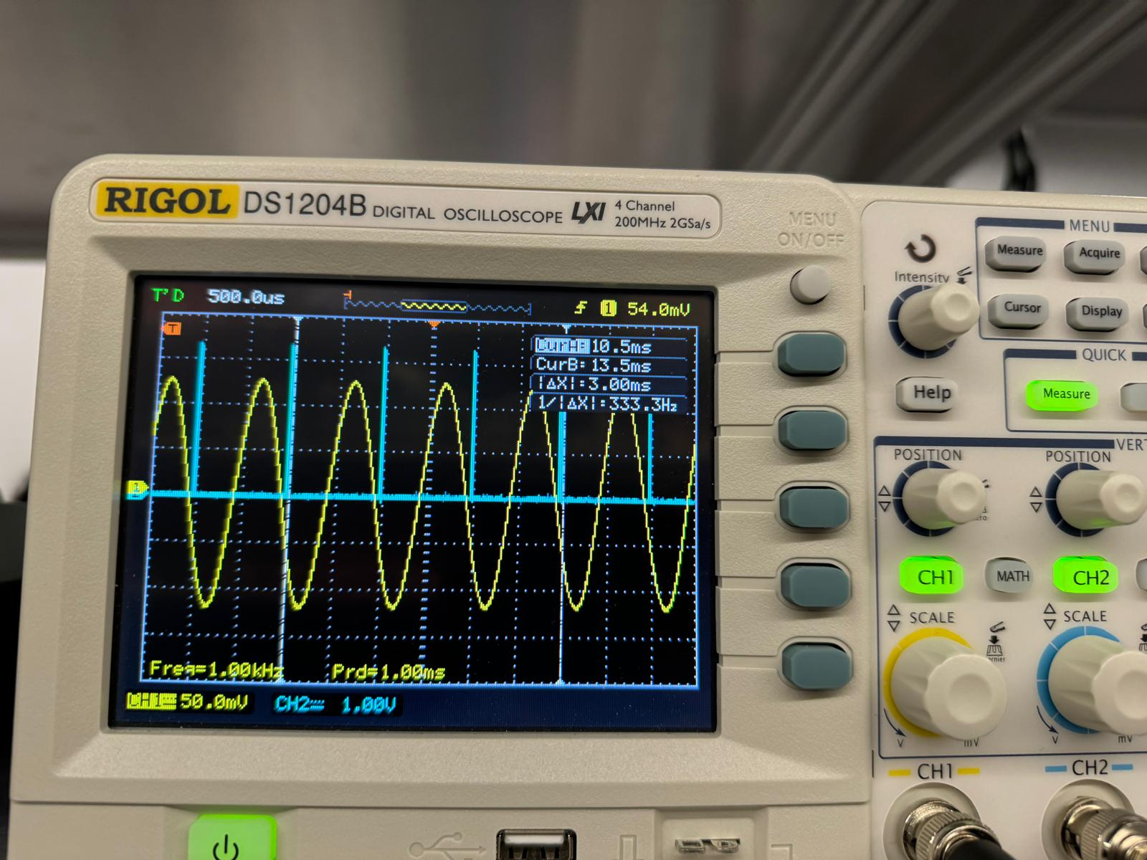
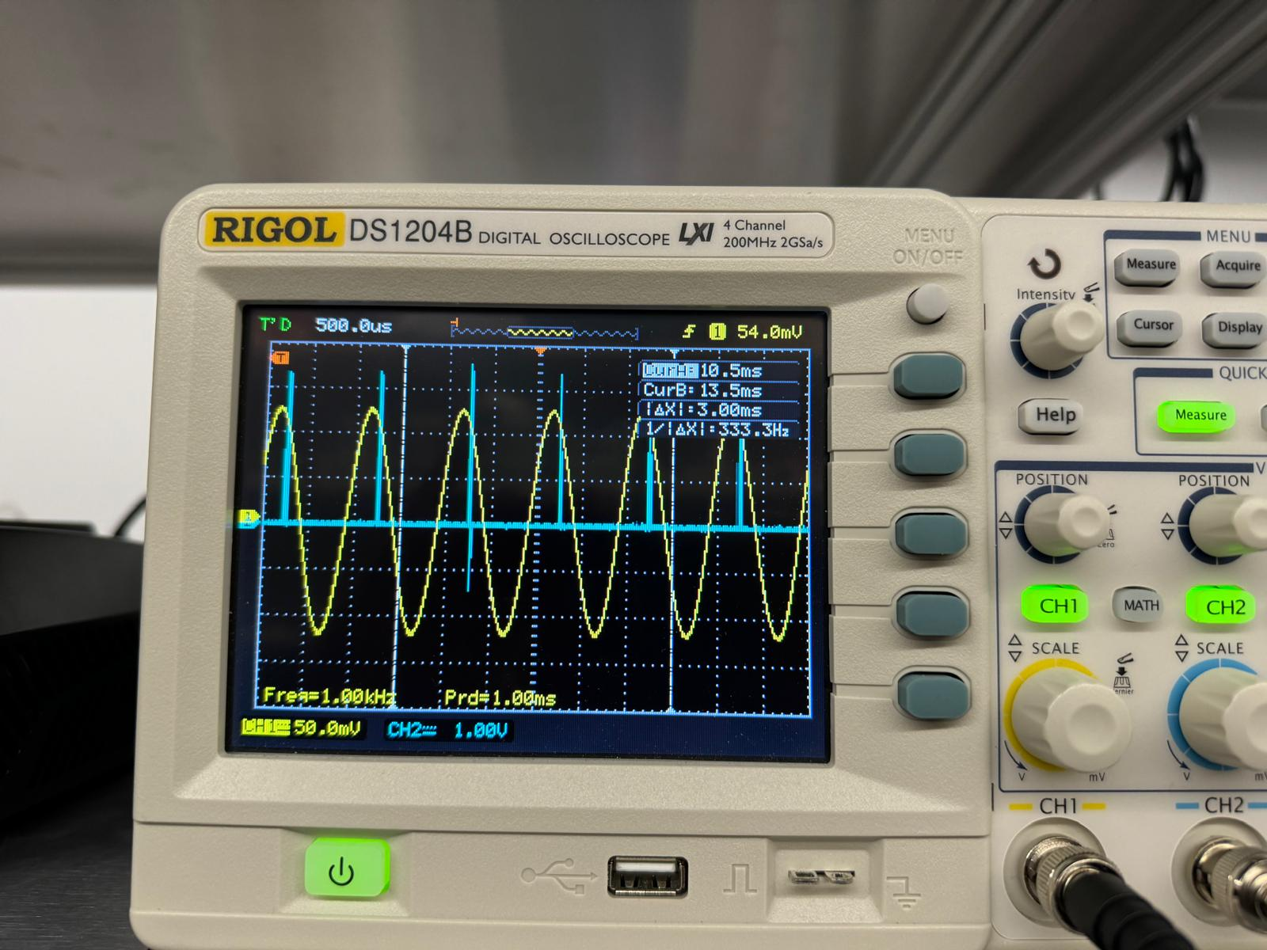
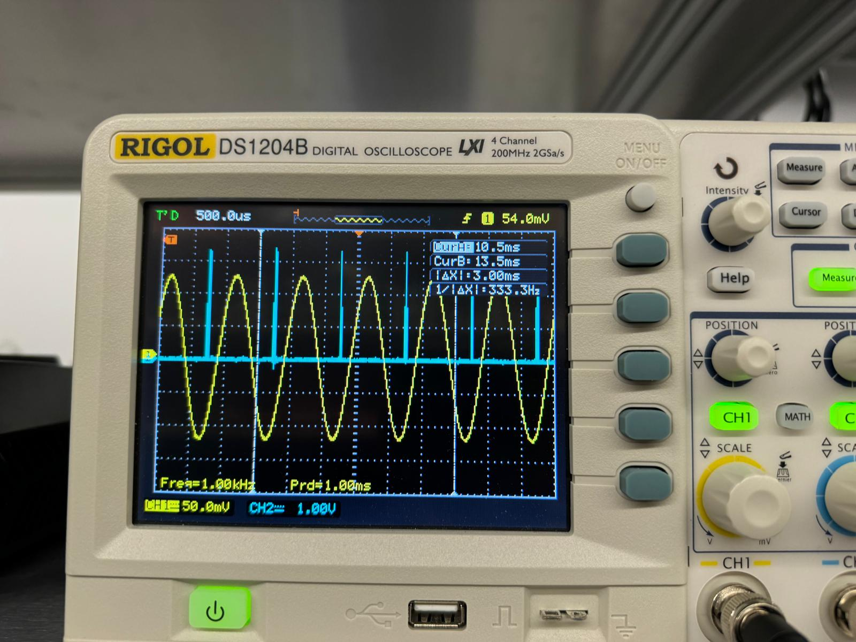
Computer controlled delays
Now that the communication is re-established, the computer can control how much to delay the triggers by
Each of these are sent by the computer and were changed from the terminal
0, ¼, ½, ¾ work!
With computer controlled input and delays, we should be back up and running right?
Introducing both, the trigger pin went flat…
Why?

Slide 8
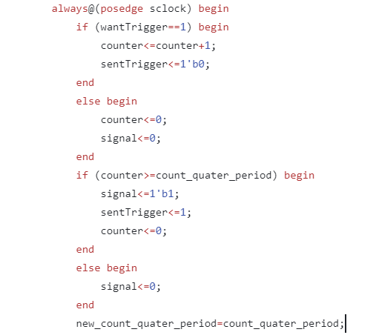
Fixing delay issues
‘count_qauter_period’ is a variable that prevents redoing already requested delays – ensures sequence of 0, ¼, ½ , ¾ delayed triggers.
Assigning it at the bottom, caused the system to falsely update, making the FPGA think it sent a trigger that never went through
Moving this reassignment up ensures the FPGA will only move onto the next delay once a trigger has successfully been sent.
delay block verilog code

Slide 9
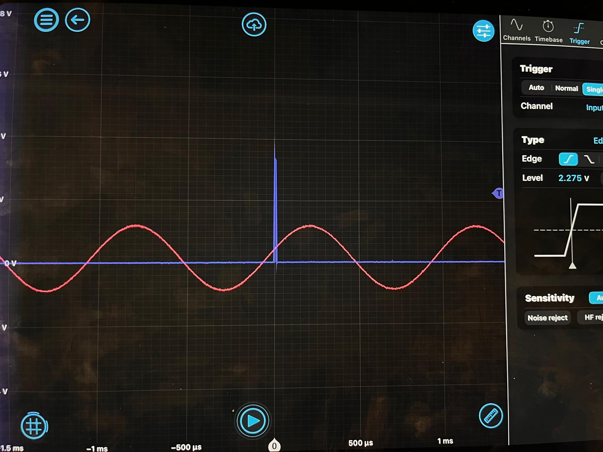
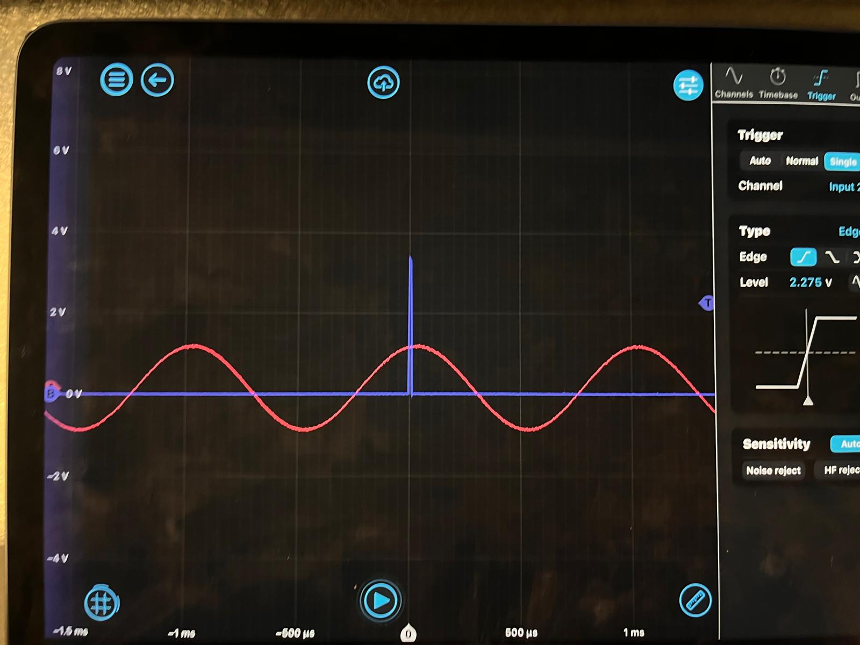
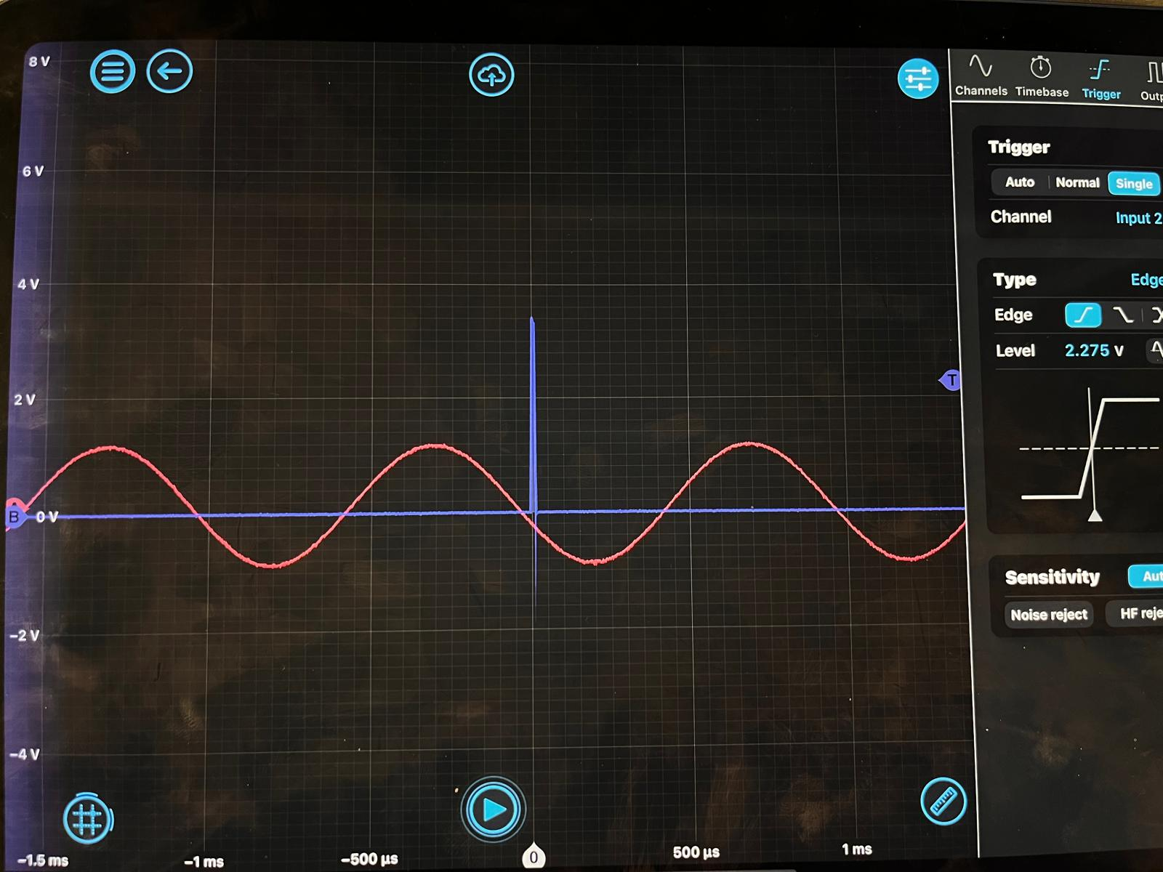
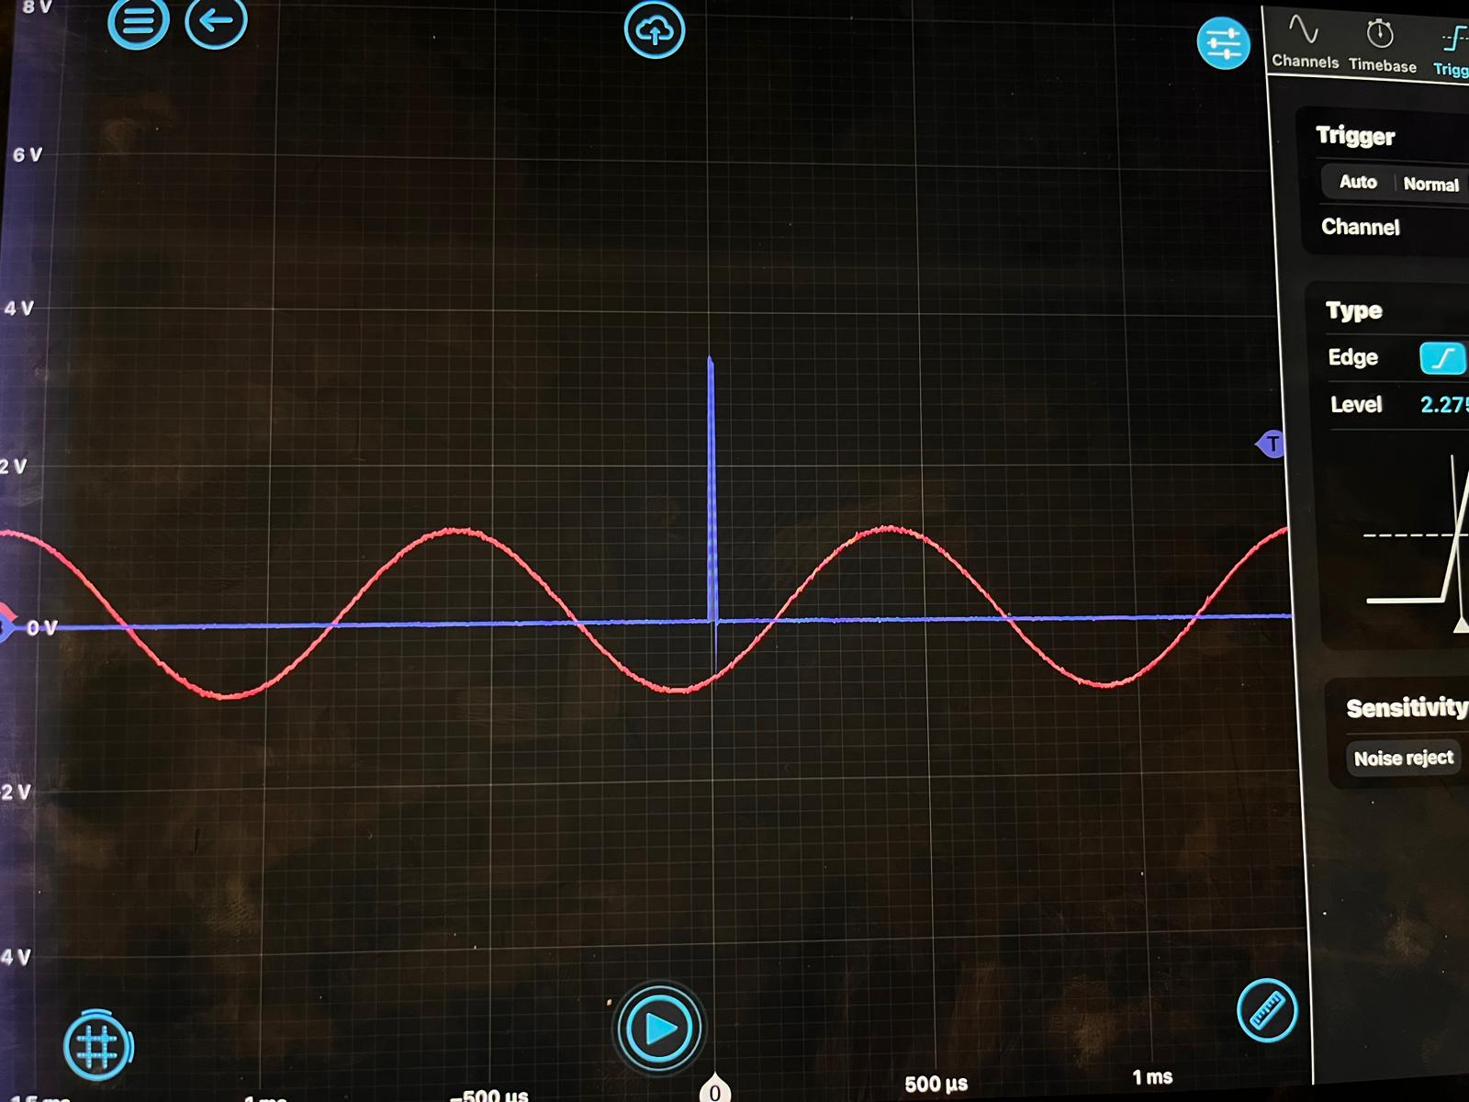
Fixing delay issues
Fixing that Verilog issue allowed me to sent individual commands to the Red Pitaya where the trigger pin would send one delay signal and then stop, waiting for the next to come!
Now we can introduce the rest of the system!

Slide 10
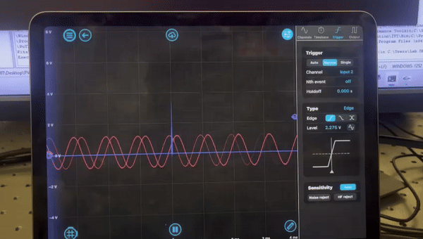
Putting it together!
NOTE: The oscilloscope is triggering every time it sees a trigger from the trigger pin. There are several periods passing between each of those blue lines in reality.

Slide 11
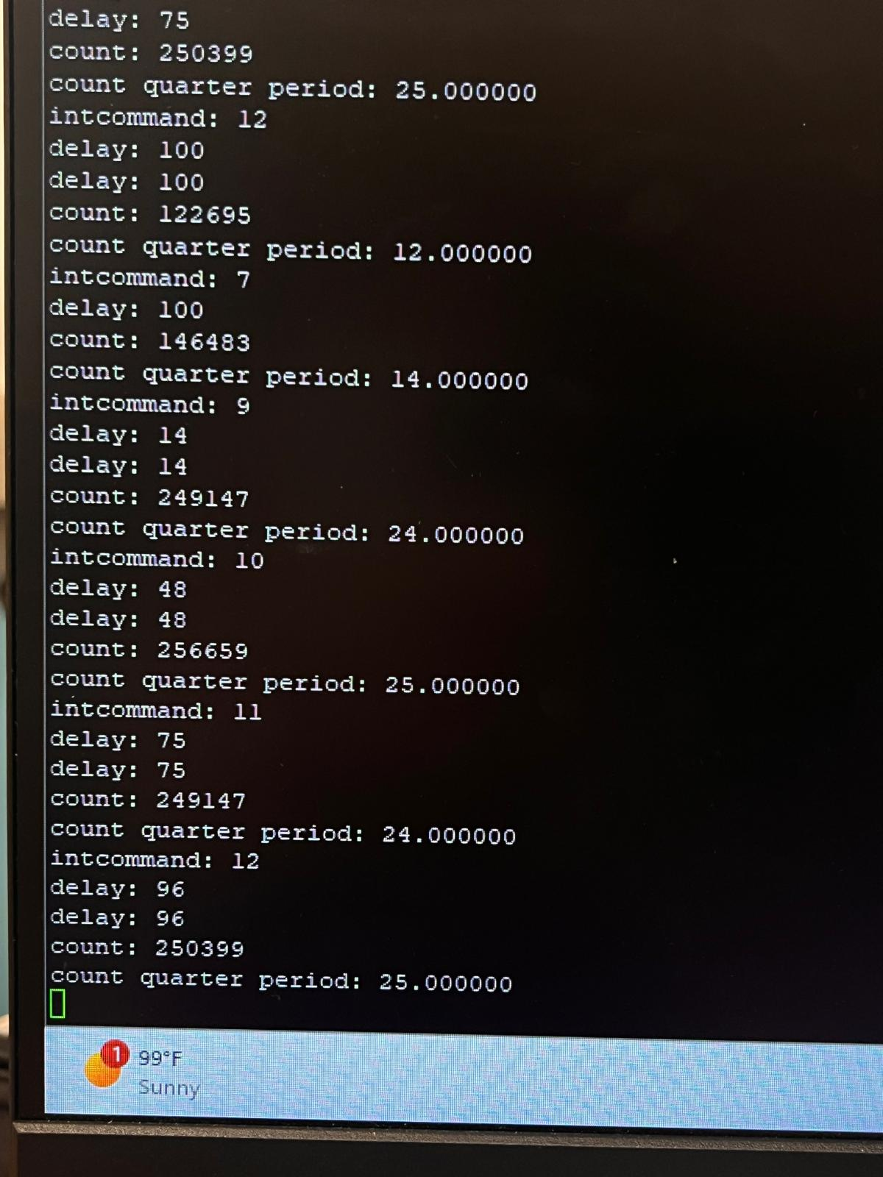


Current issues: Frequency Counter
For whatever reason, the frequency counter is having some trouble. It will sometimes output numbers that are not reasonable.
For 1kHz, we expect the count quarter period = 25, something messes it up sometimes
What is weird, this problem gets introduced with something very unrelated…

Slide 12
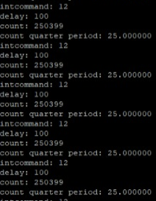
Current issues: Frequency Counter
Inside the delay logic in Verilog, there is this conditional statement:
This conditional checks for:
1) is there a rising edge? (rt==1)
2) is there a new delay command? (new_count_qauter_period != count_quater_period)
Changing it to
Ie. Just is there a rising edge?
Results in a much more stable system Much more stable around the 25 value we expect…

Slide 13
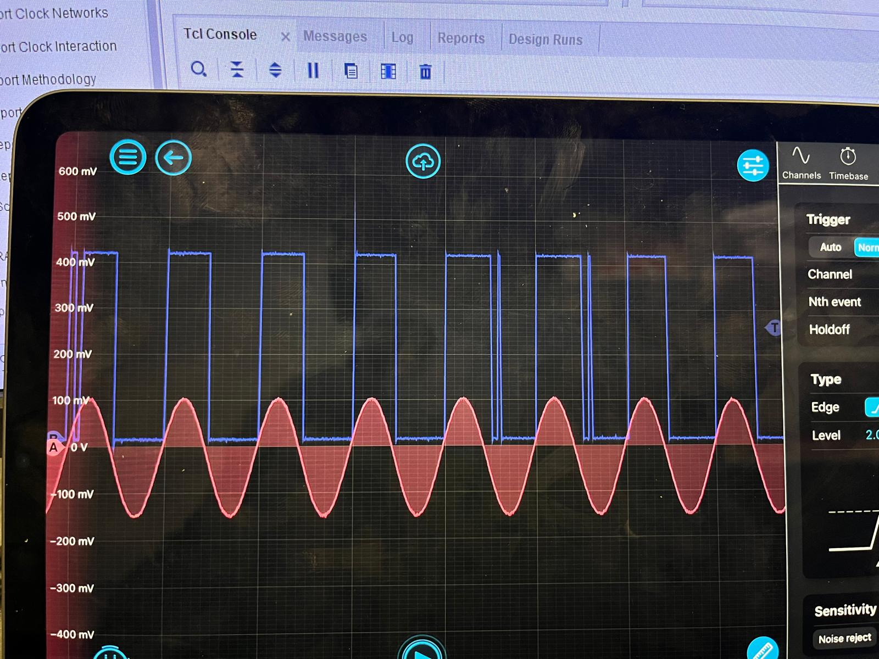
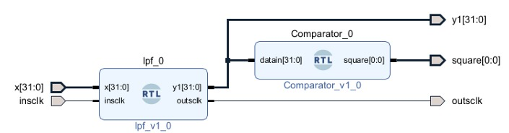
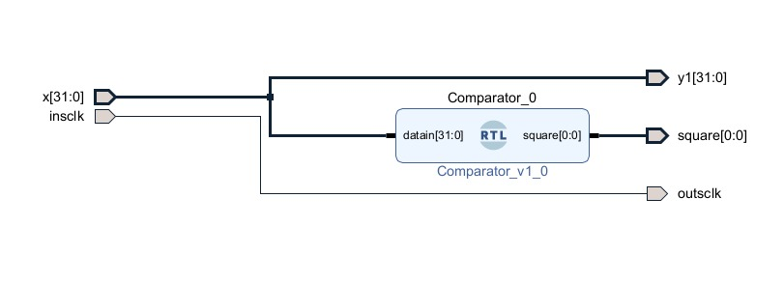
Fixing the instability – removing the low pass filter
Notice how the square signal is not very good…

Slide 14
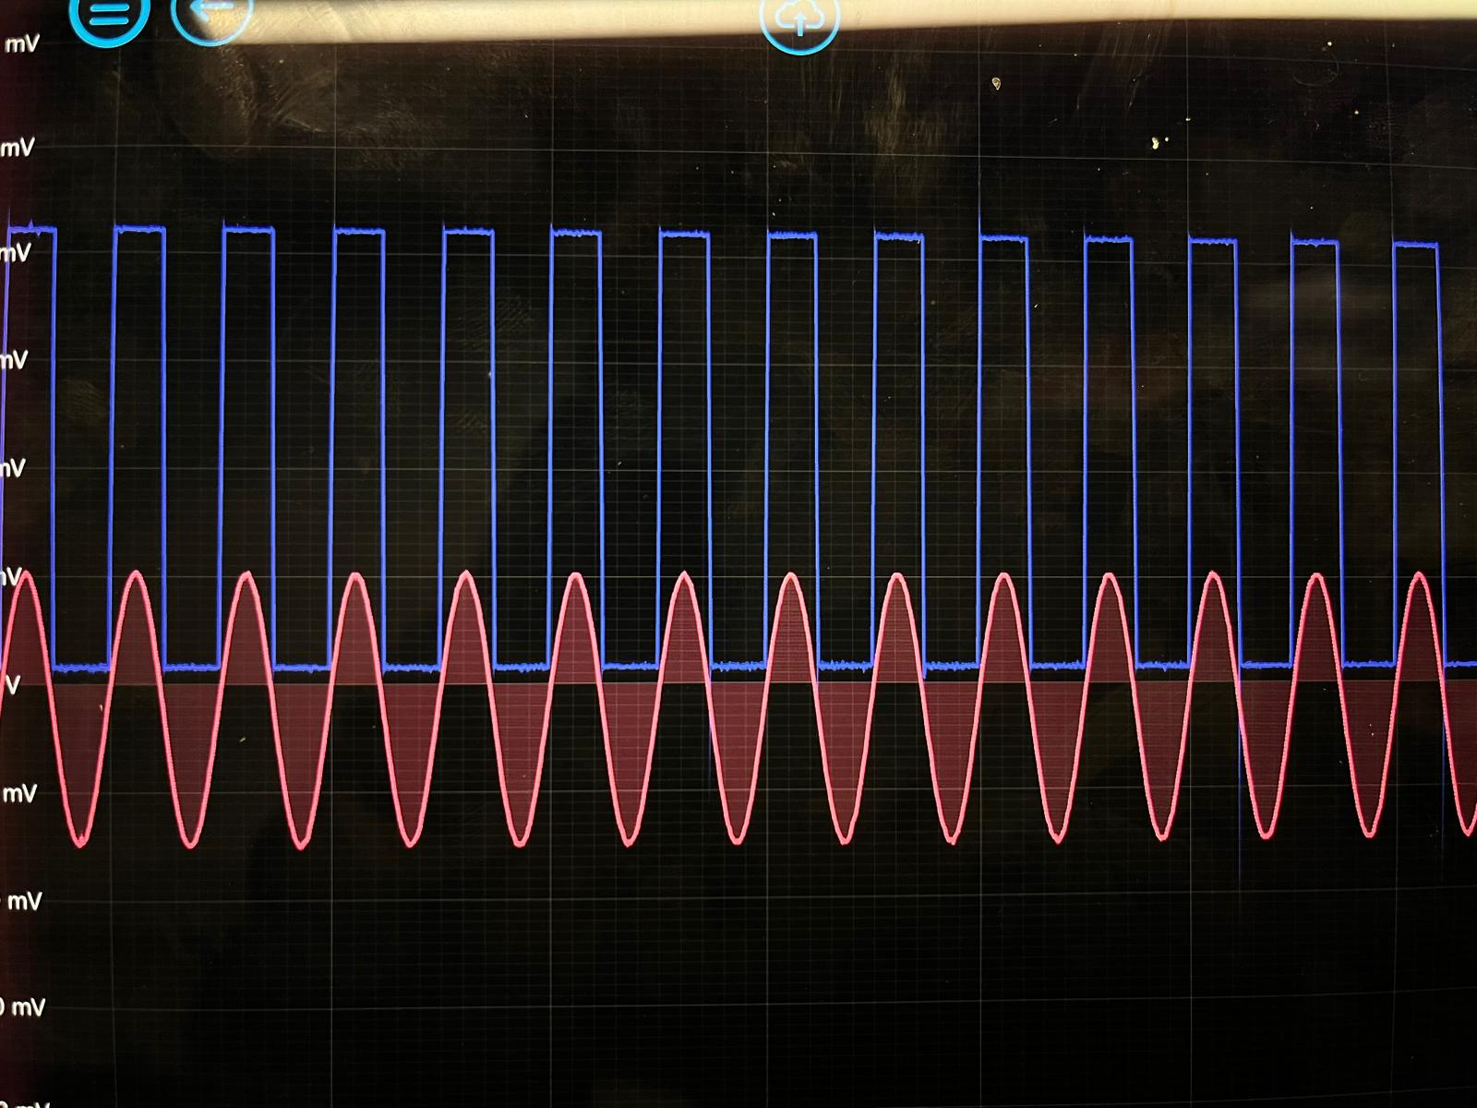
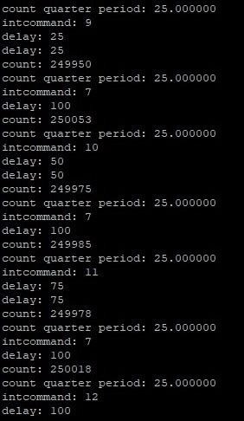
Fixing the instability – removing the low pass filter
For a 1kHz signal, we expect: count quarter period = 25
And this is what we get!
Much much cleaner square signal!

Slide 15
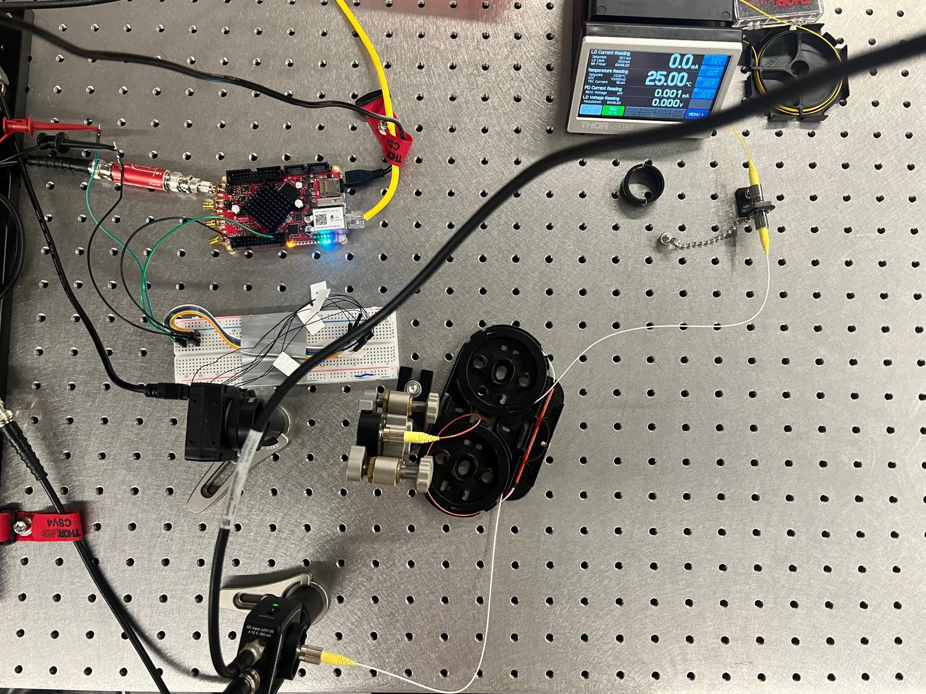
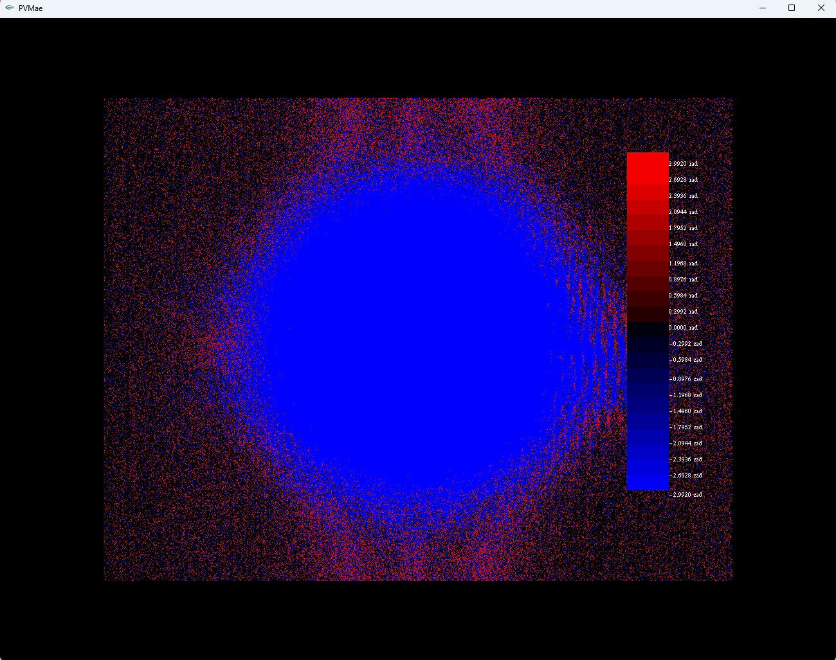
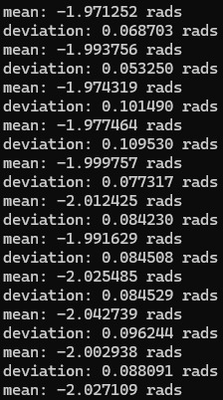
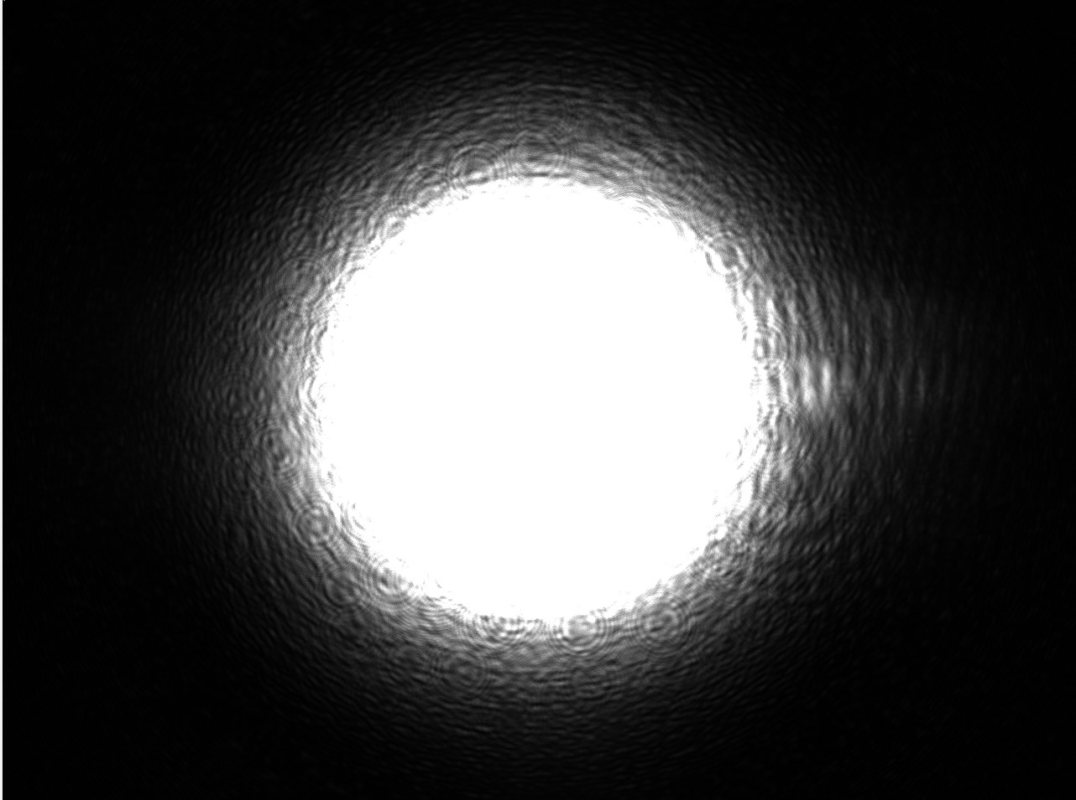
Results
1kHz frequency, 1% attenuation filter, 24 microsend shutter speed (long)

Slide 16
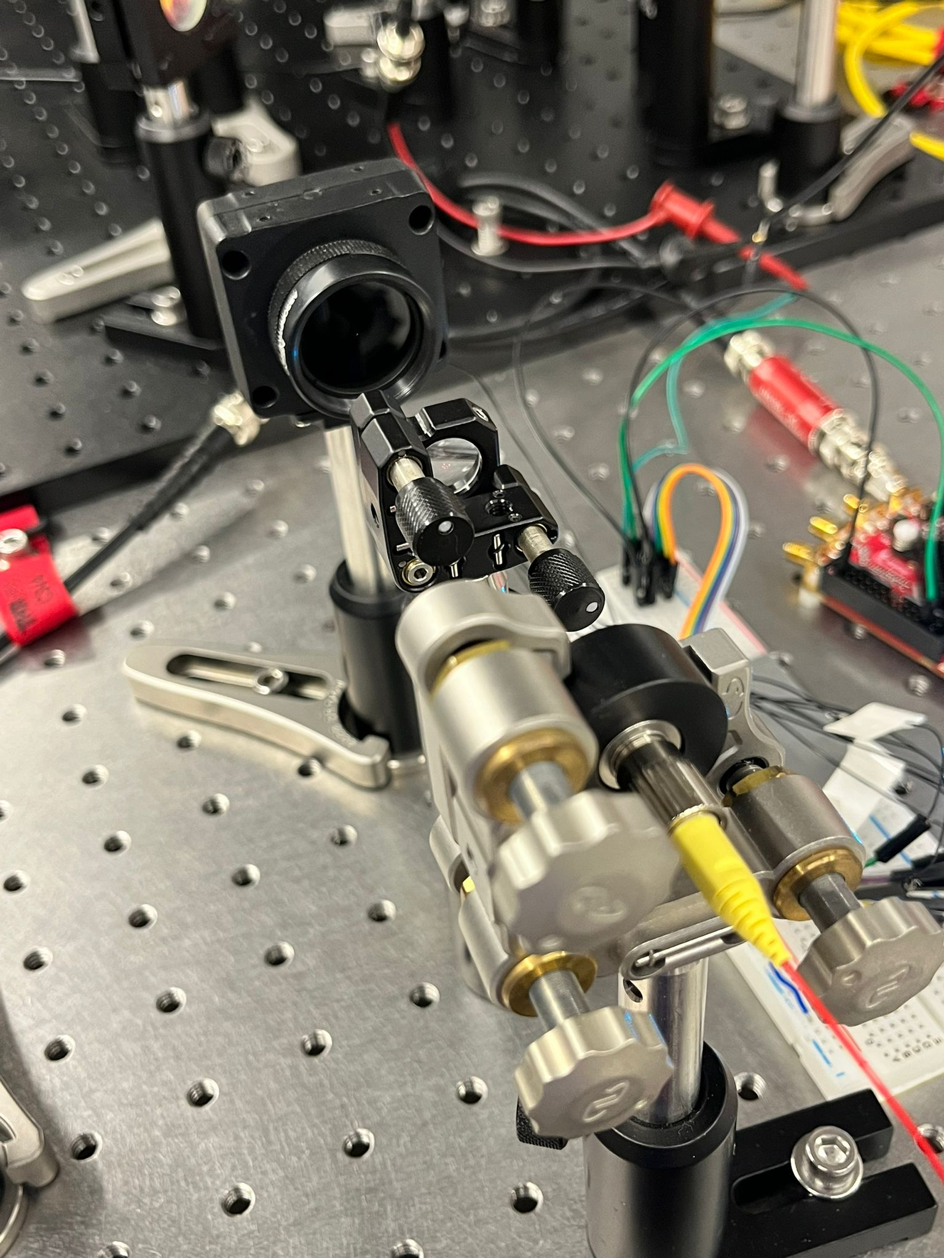
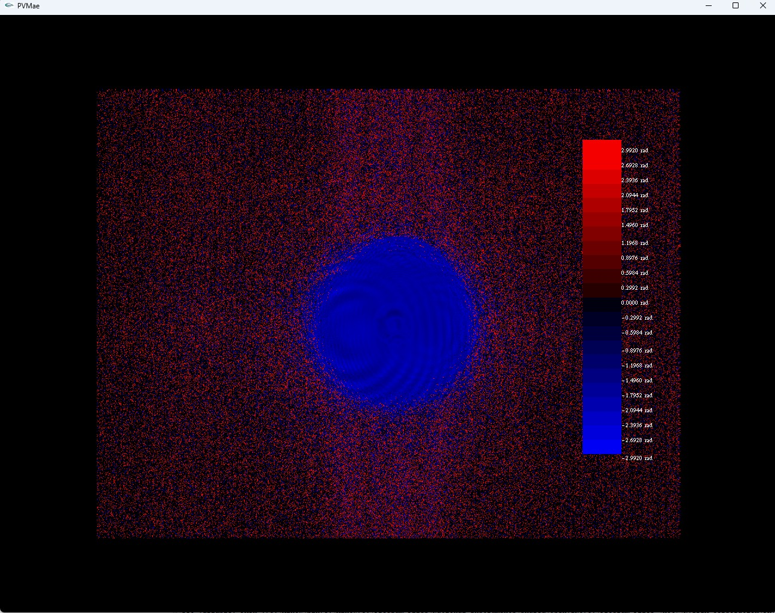
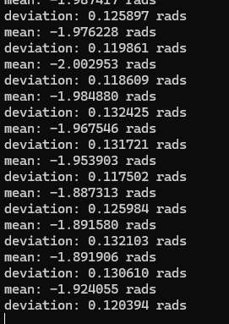
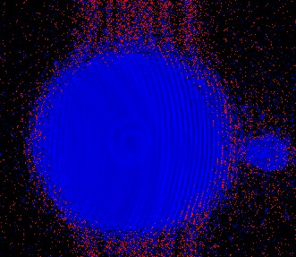
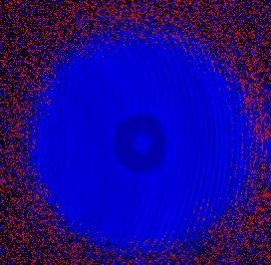
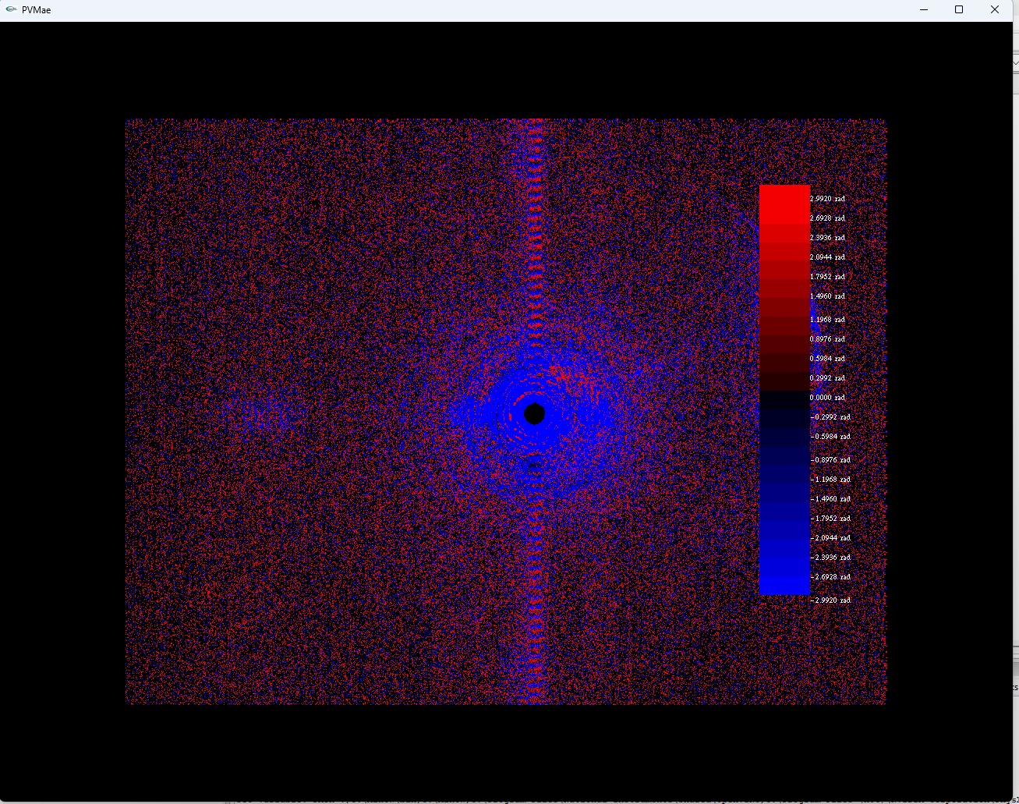
Results – Bi Convex Lens
Lens Info: LB1844, F = 50.0mm

Slide 17
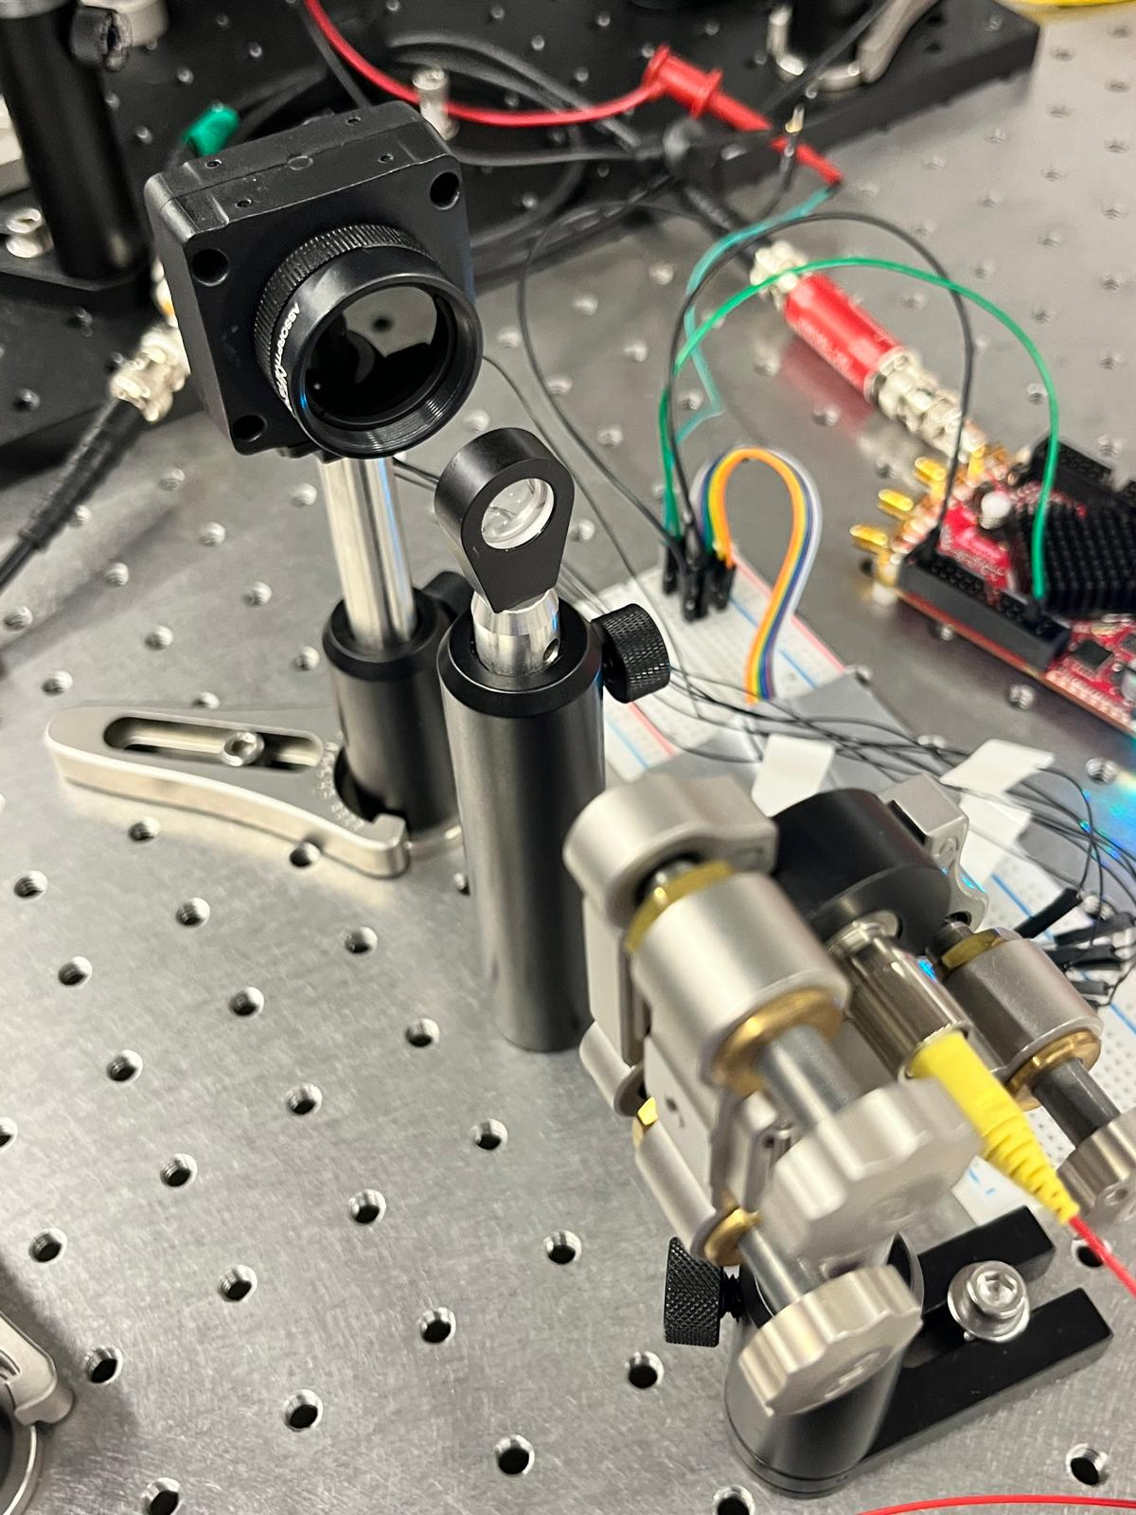
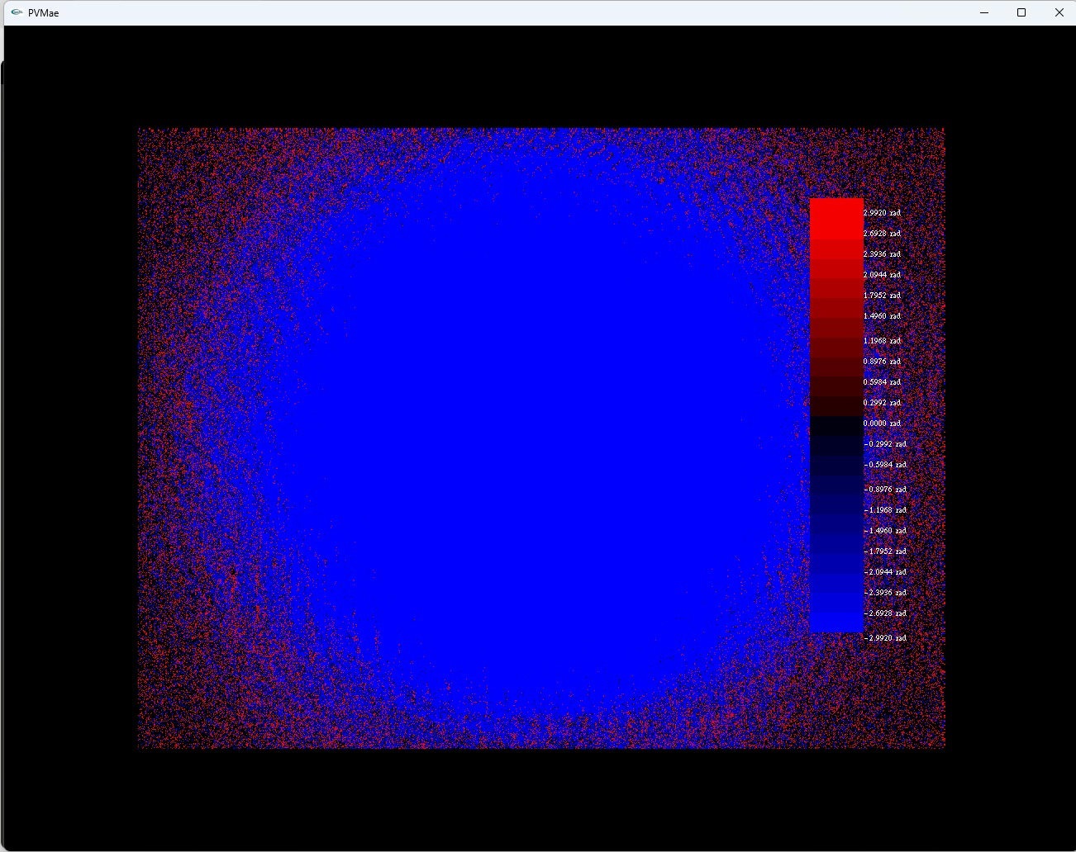
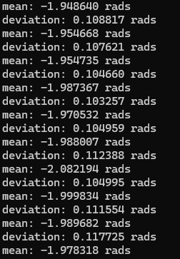
Results – Bi Concave Lens
Lens Info: LB1357, F = -50mm

Slide 18
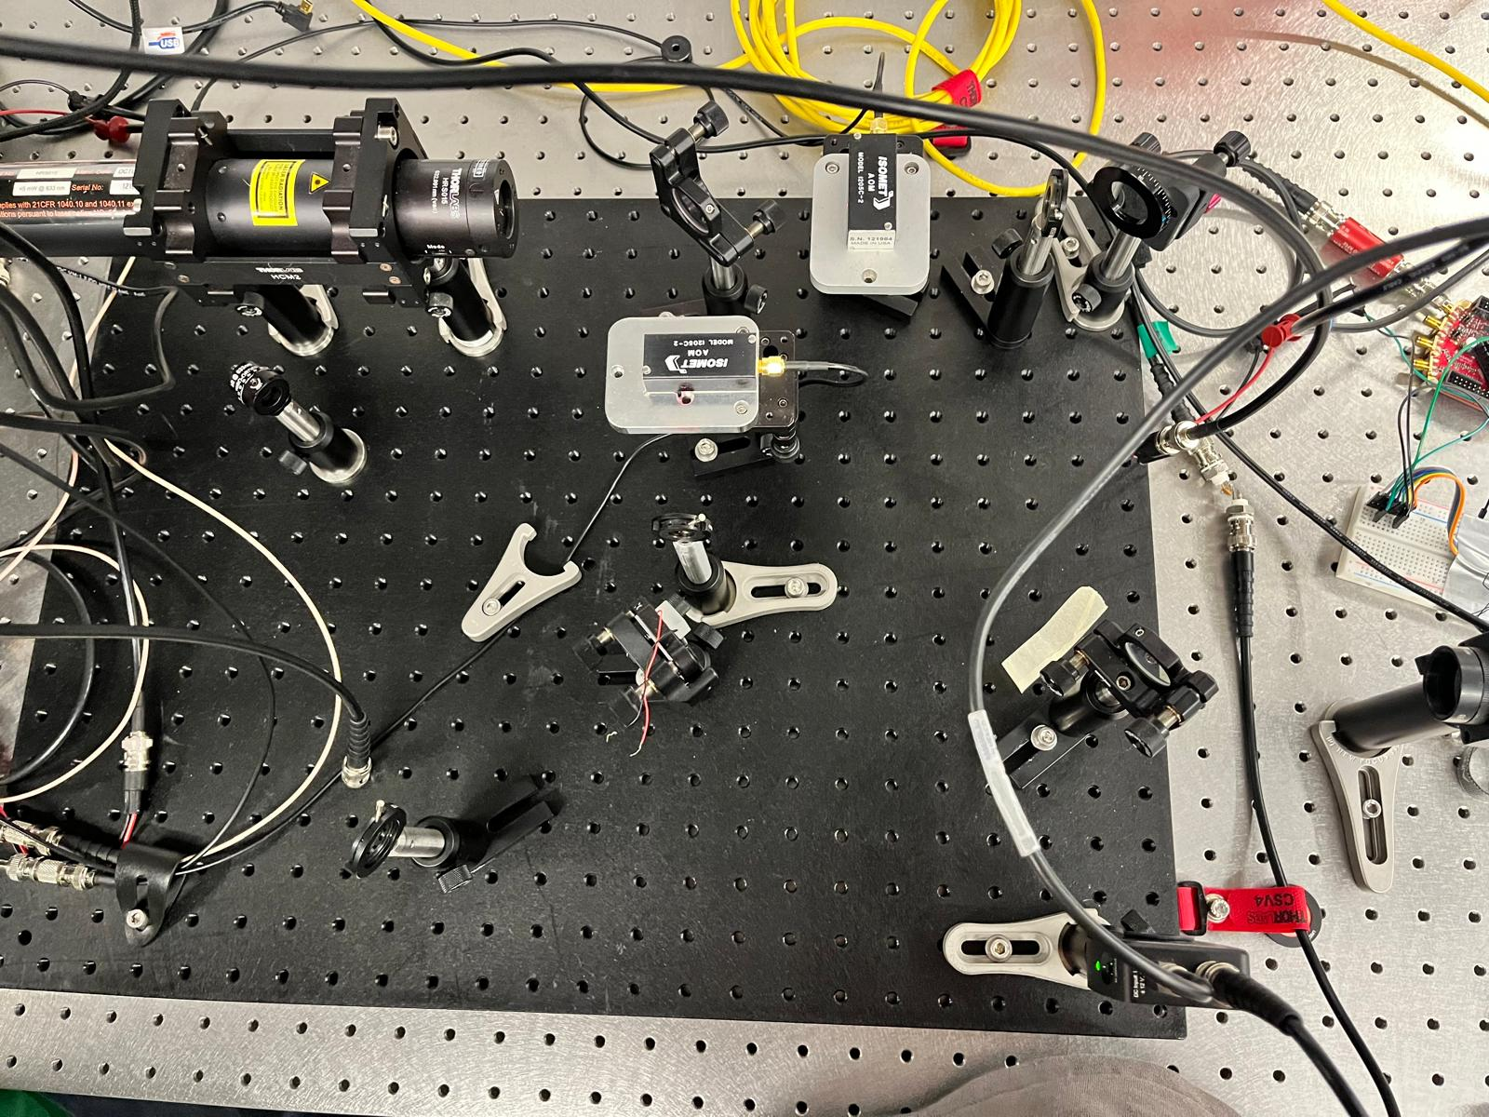
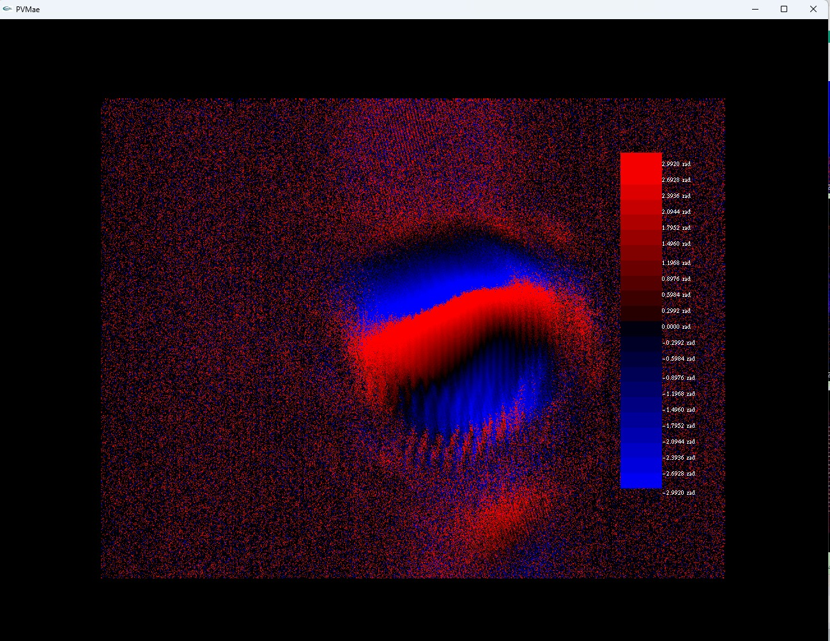
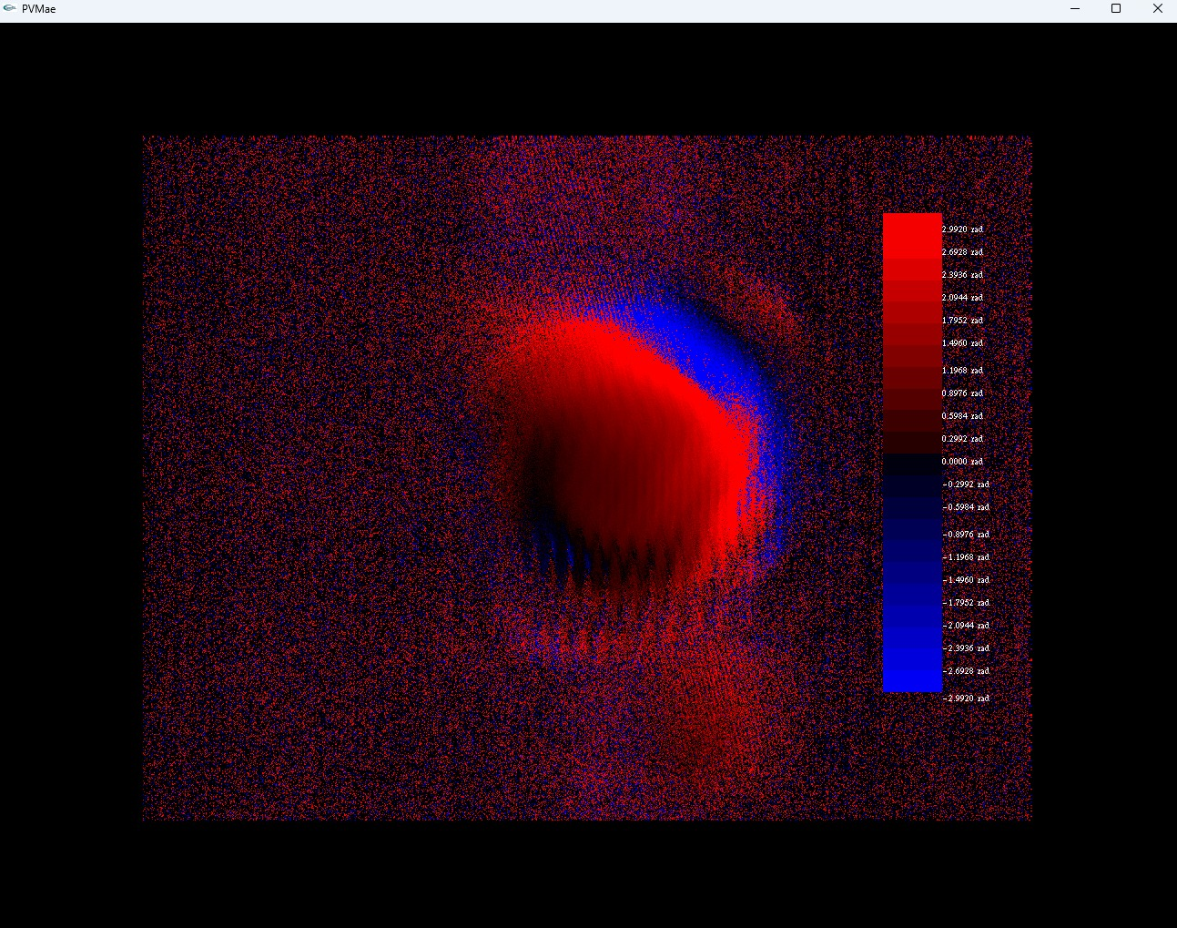
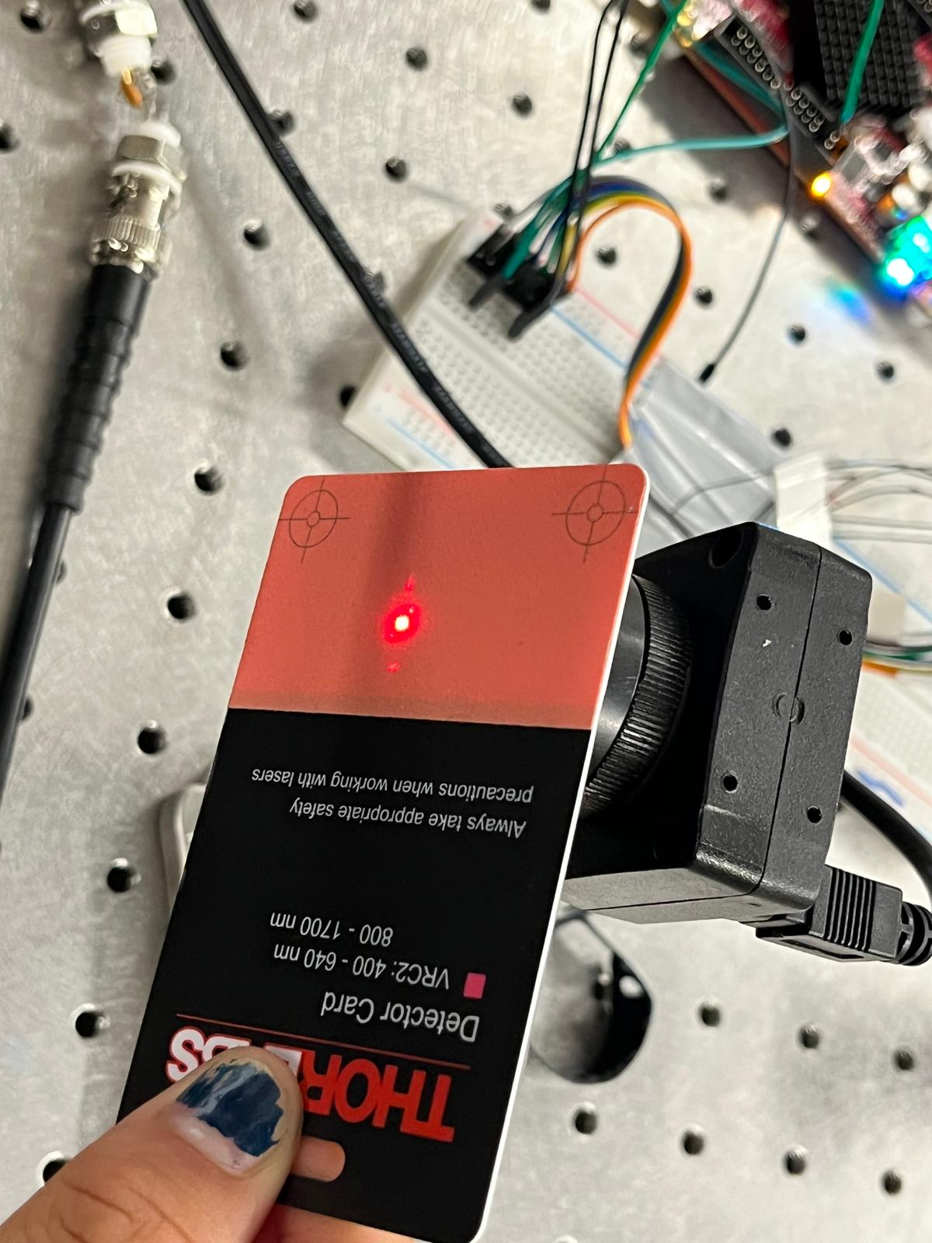
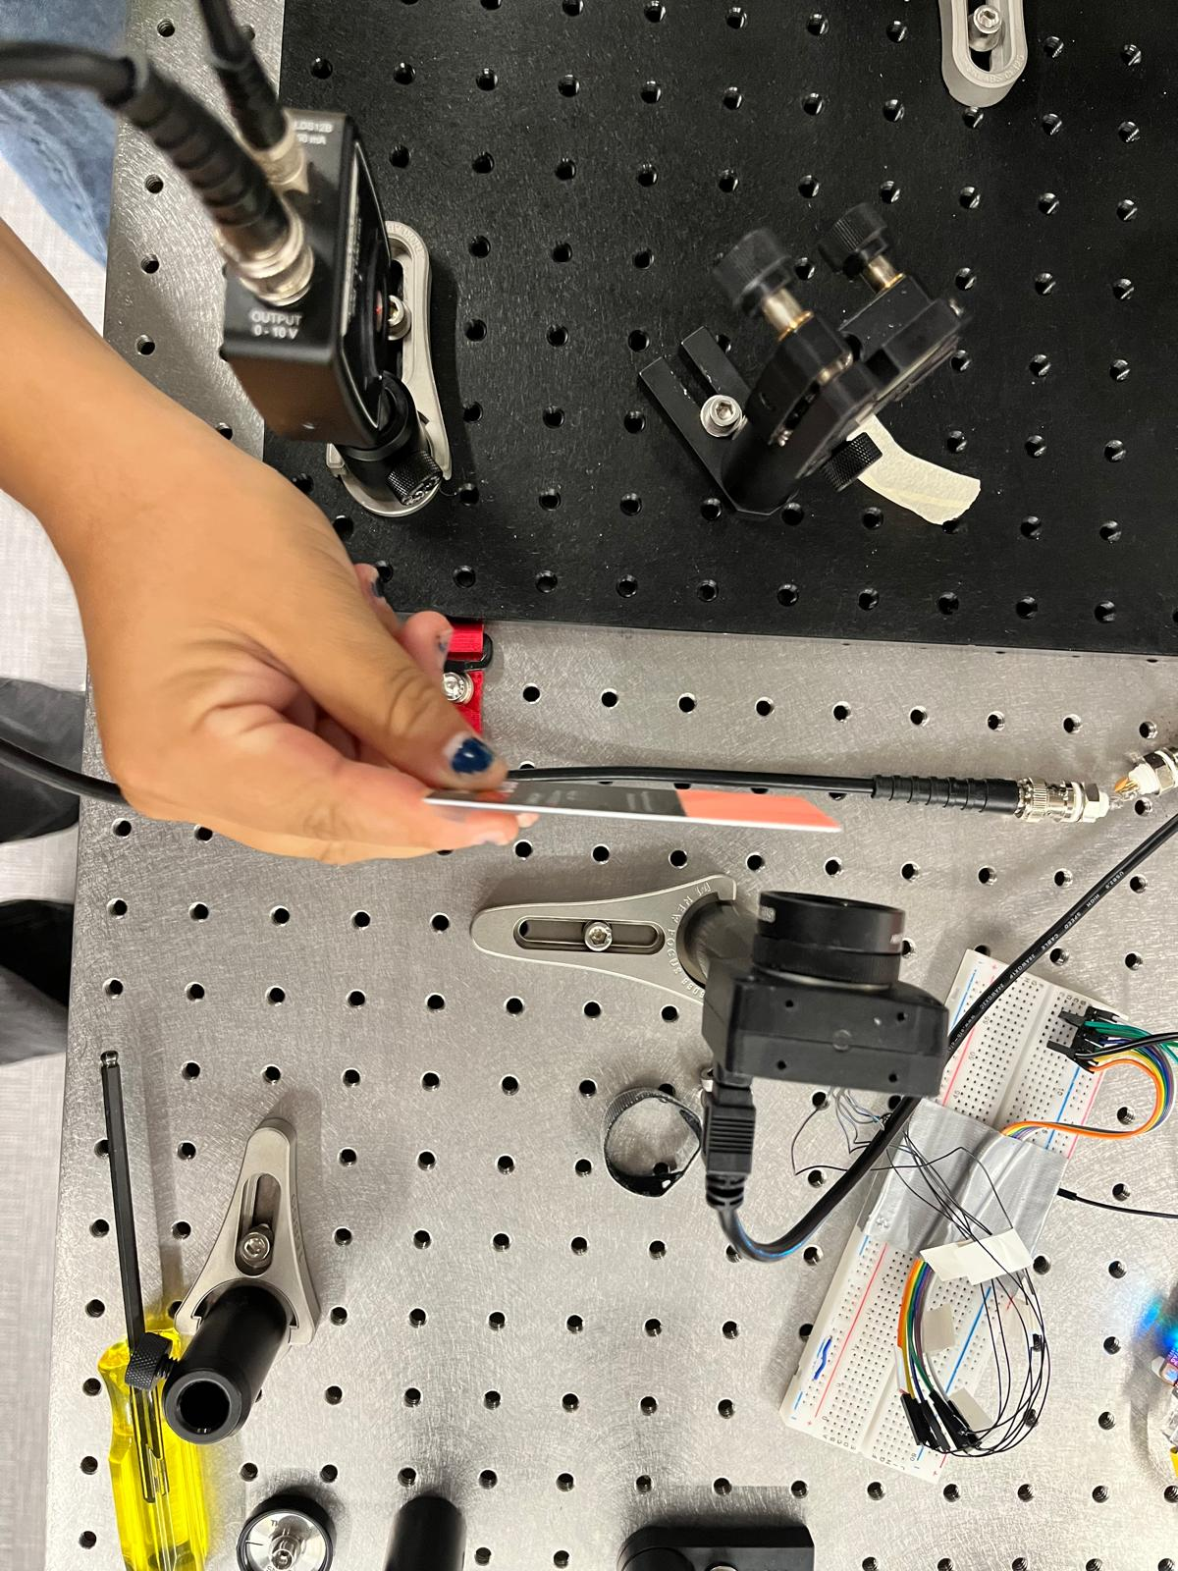
Results – Misaligned Red Interferometer
Quick and dirty first attempt – Heterodyne Frequency: 1kHz
It is not well aligned, so you we don’t see the nice concentric bands, but you can see fringes which is cool!

Slide 19
Noise Hunting
Josh’s Ideas for how to noise hunt:
Digital Filter – currently the low pass introduces noise
Analog filter – right now the signal’s mean is -57mVpp… make a new one probably
Look into Y8 vs Y16 modes for the Camera
Clocking
For the 0 crossing image, switch from wait 1 period, to take picture instantly

